Slide 1
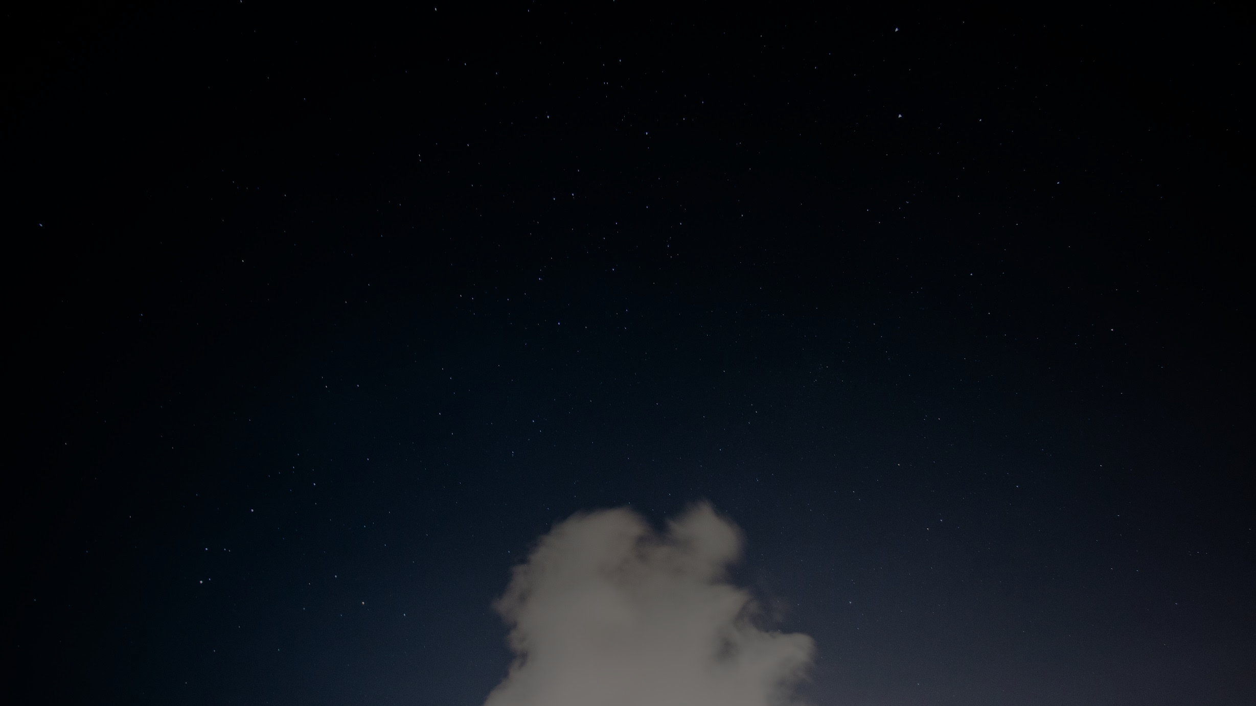
Combining Galaxy Cluster Abundance and Weak Lensing to Derive Cosmological Parameters
Gladys Muthoni Kamau
Boise State University

Slide 2
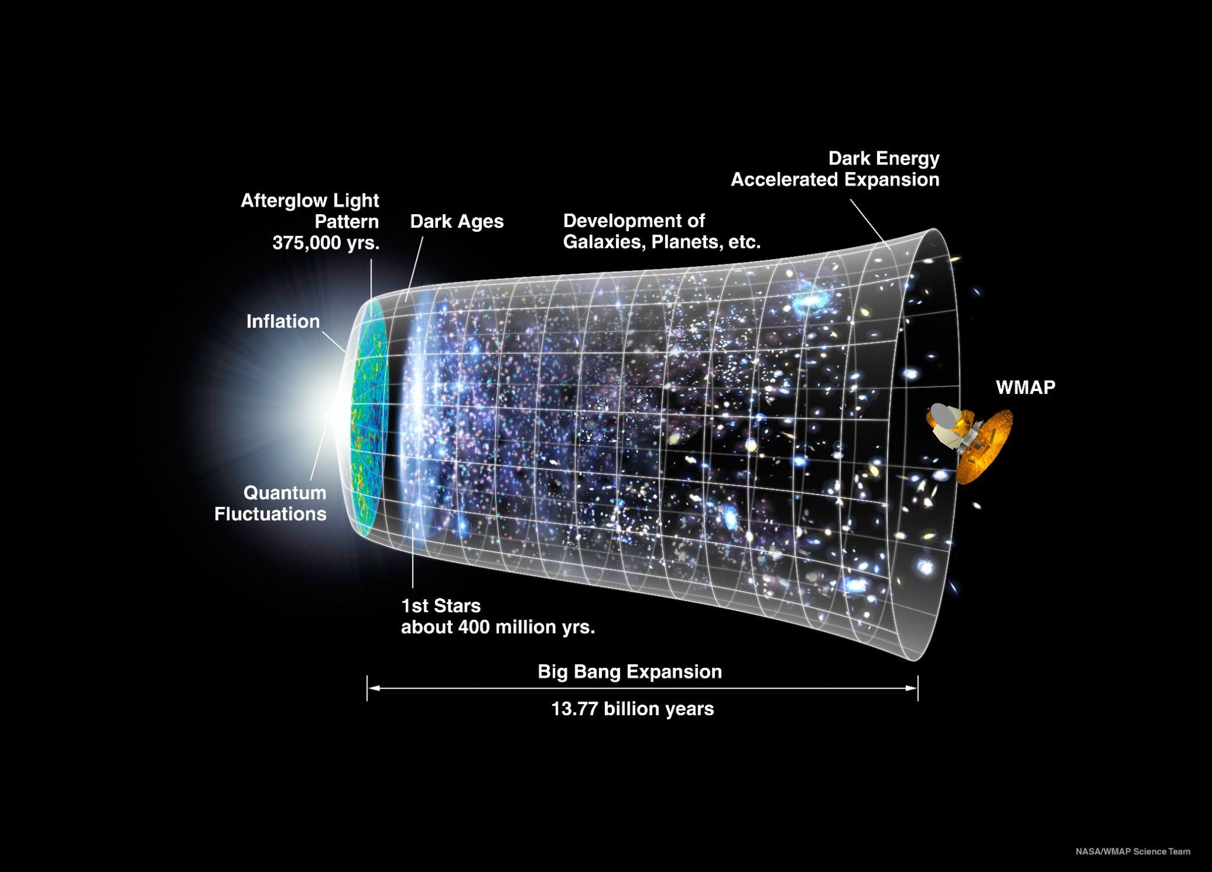
Introduction
Credit: NASA/WMAP Science Team

Slide 3
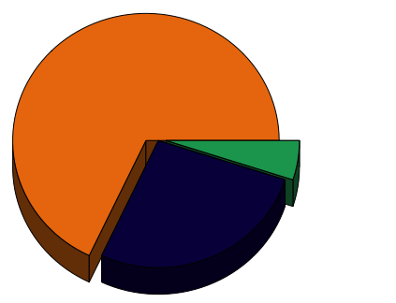
Introduction
Introduction
Dark Energy (68%)
Ordinary
Matter (5%)
Dark Matter (27%)
Today
Planck Collaboration 2014

Slide 4
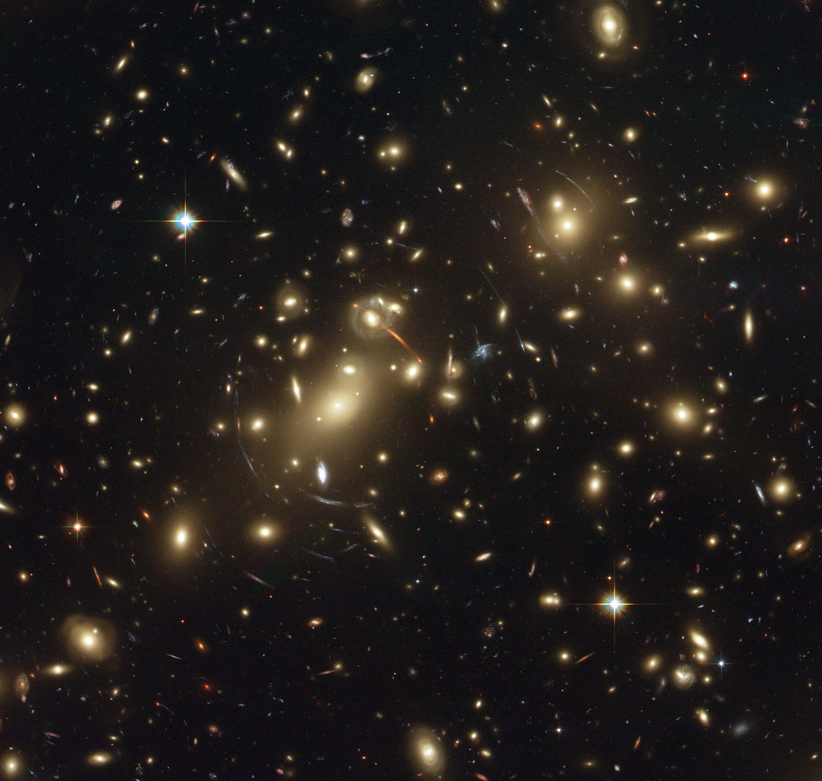
Introduction
Introduction
Cluster - the largest objects in the Universe containing hundreds to thousands of galaxies.
Richness - Number of galaxies belonging to a cluster.

Slide 5
Primary papers
Dark Energy Survey Year 1 Results: Weak Lensing Mass Calibration of redMaPPer Galaxy Clusters
Model WL systematics and fit WL mass to constrain mass--richness relation.
Dark Energy Survey Year 1 Results: Cosmological Constraints from Cluster Abundances and Weak Lensing
Derive Ω_{m} and σ₈ parameters.
The Impact of Projection Effects on Cluster Observables: Stacked Lensing and Projected Clustering
Quantify the impact of projection effects on cluster clustering, cluster abundance, and cluster lensing.
Optical Selection Bias and Projection Effects in Stacked Galaxy Cluster Weak Lensing
Probe selection bias of stacked weak lensing signal measured from clusters identified using redMaPPer algorithm.

Slide 6
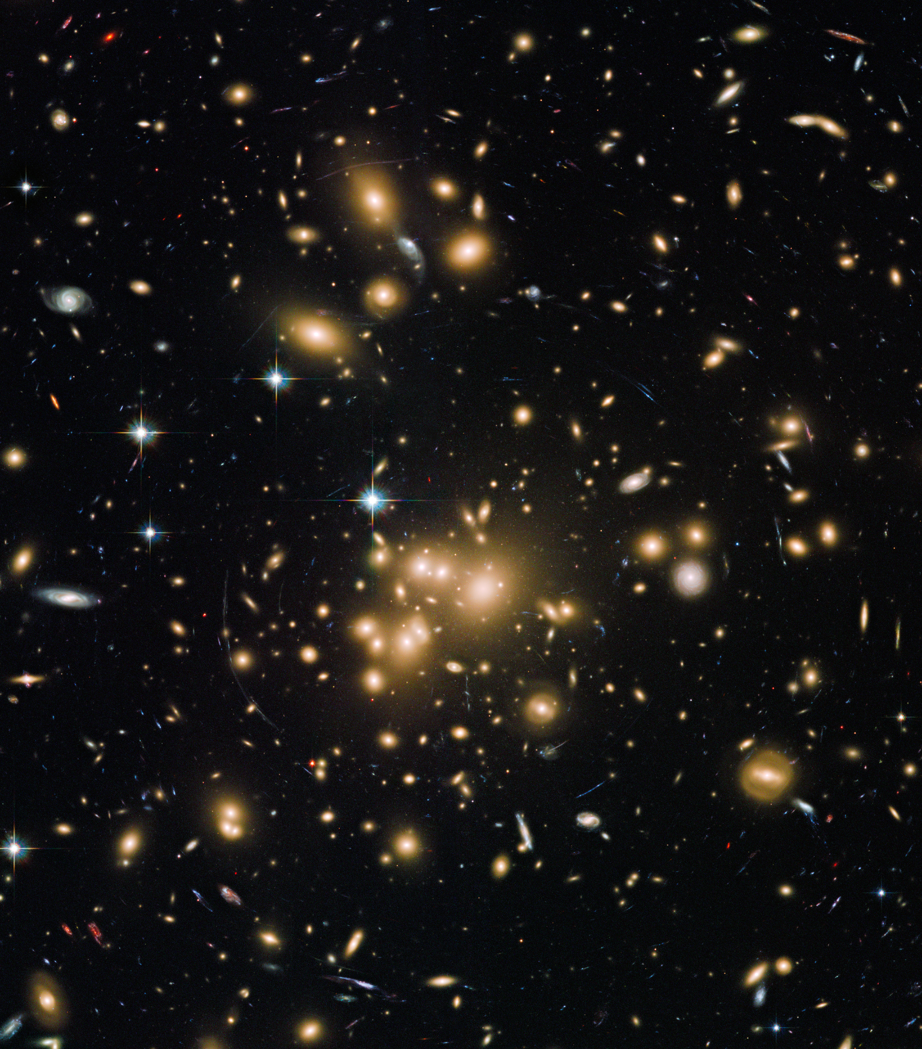
McClintock et al 2019
Sunayama et al 2020, Wu et al 2022
Mass [M☉]
Simulation (Projection effects)
Richness
WL Mass and mass–richness relation
Abbott et al. 2020
(σ₈ , Ω_{m} )
Observational systematics
McClintock et al 2019
Number density
Mass

Slide 7
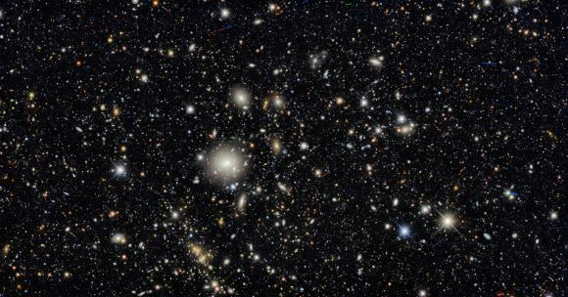
Dark Energy Survey (DES)
Deep sky observation of galaxies. The image results from long-time exposure of the DECam on a portion of the sky to show a peek at distant and fainter galaxies.
(Credit DES/DOE/FNAL/DECam/CTIO/NOIRLab/NSF/AURA)

Slide 8
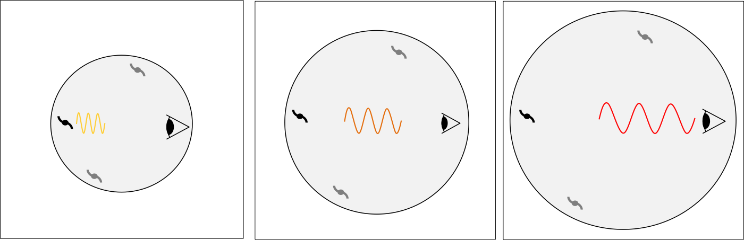
Data
Photometric redshift catalog - use of redshift estimates to estimate the distance of the cosmological objects from the Earth.
Redshift - stretched wavelength due to the expansion of the Universe.
Shear catalog - contains the direct observables (galaxy shapes) that offer a direct way to measure the weak lensing profile of the clusters.
Cluster catalog - clusters were identified using the redMaPPer algorithm.

Slide 9
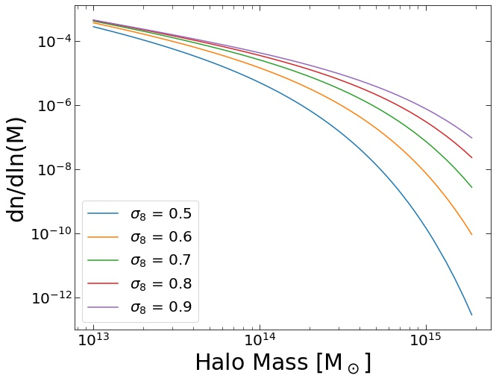
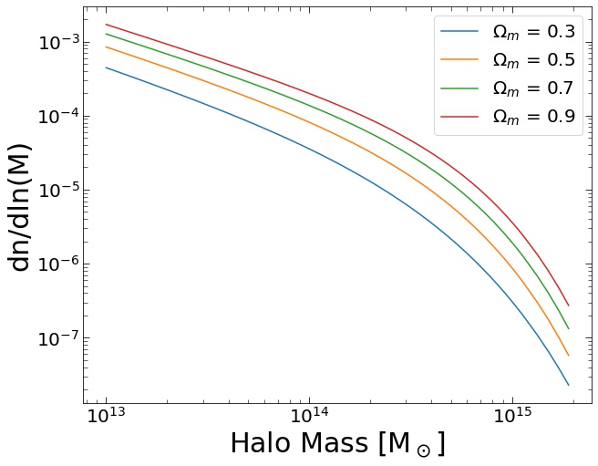
Main Model: Halo Mass Function (HMF)
Halo number is sensitive to Ω_{m} and σ₈ . HMF connects Ω_{m} and σ₈ to cluster abundance and cluster mass.

Slide 10
Mass-Richness relation
Mass [M☉]
Number density
Richness
Mass
We observe the richness of clusters directly but cannot measure the mass. Our goal is to relate richness to the estimated weak lensing mass.

Slide 11
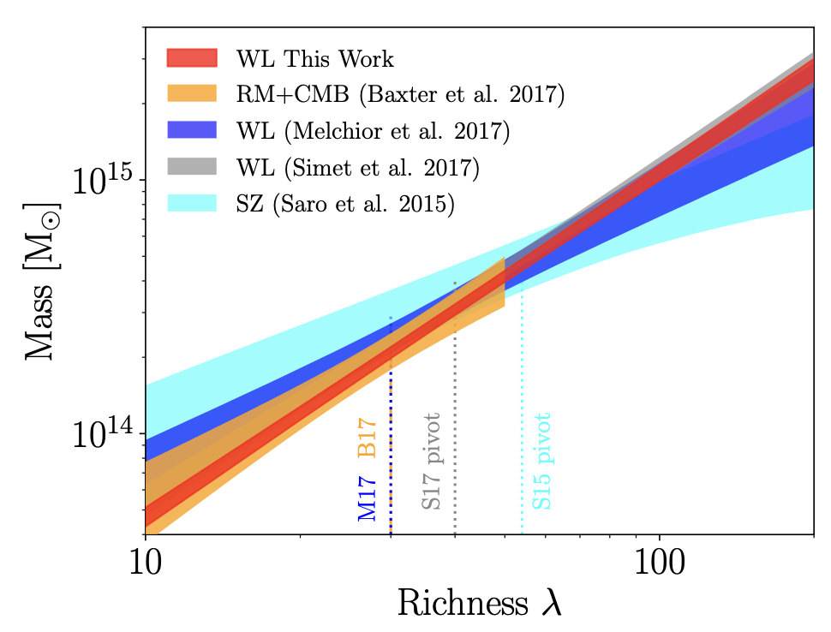
Mass-Richness relation
Source: McClintock et al 2019

Slide 12
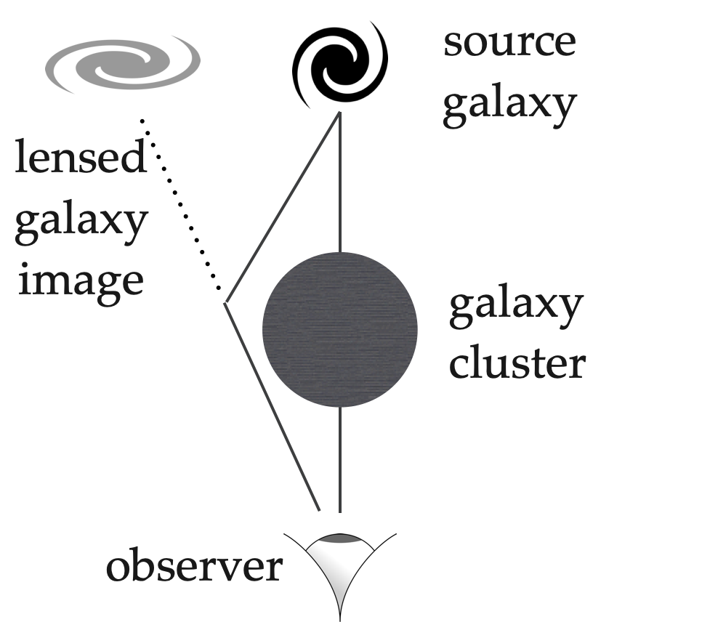
Cluster mass estimation: Gravitational lensing

Slide 13
Data vector to derive cosmology
Cluster mass - Cosmological surveys cannot observe the cluster mass directly. This study uses weak lensing measurements to estimate the cluster mass (weak lensing mass).
Cluster abundance - Refers to the number of clusters in the i^{th} richness and redshift bin. DES observes number counts as a function of richness and redshift.

Slide 14
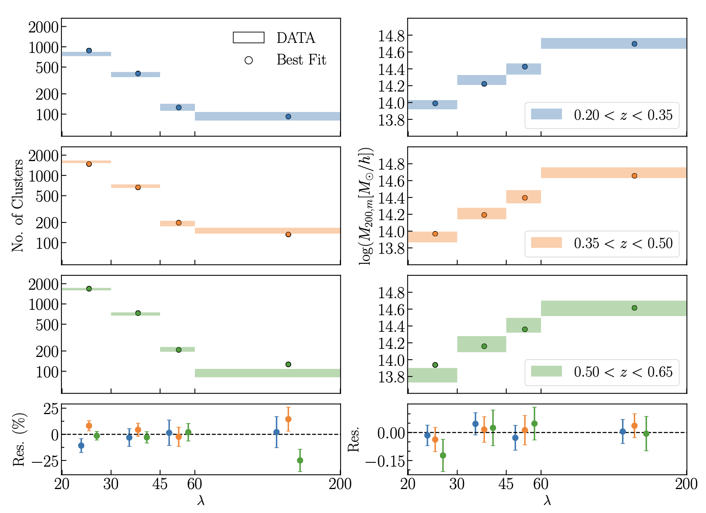
Data vector to derive cosmology
Source: Abbott et al. 2020
Notes:
Explain x and y axes
Explain each panel

Slide 15
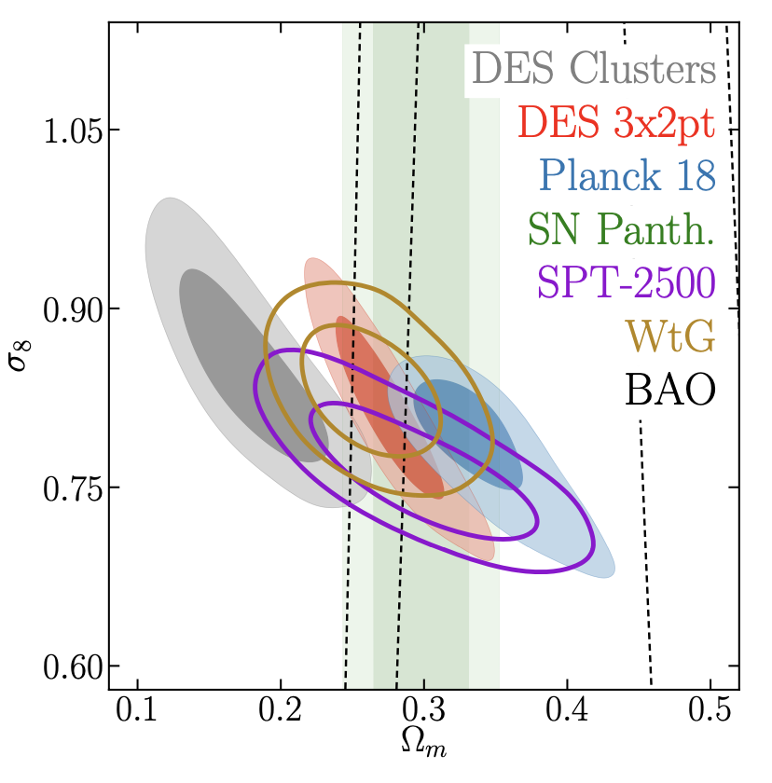
Cluster cosmology results
Source: Abbott et al. 2020

Slide 16
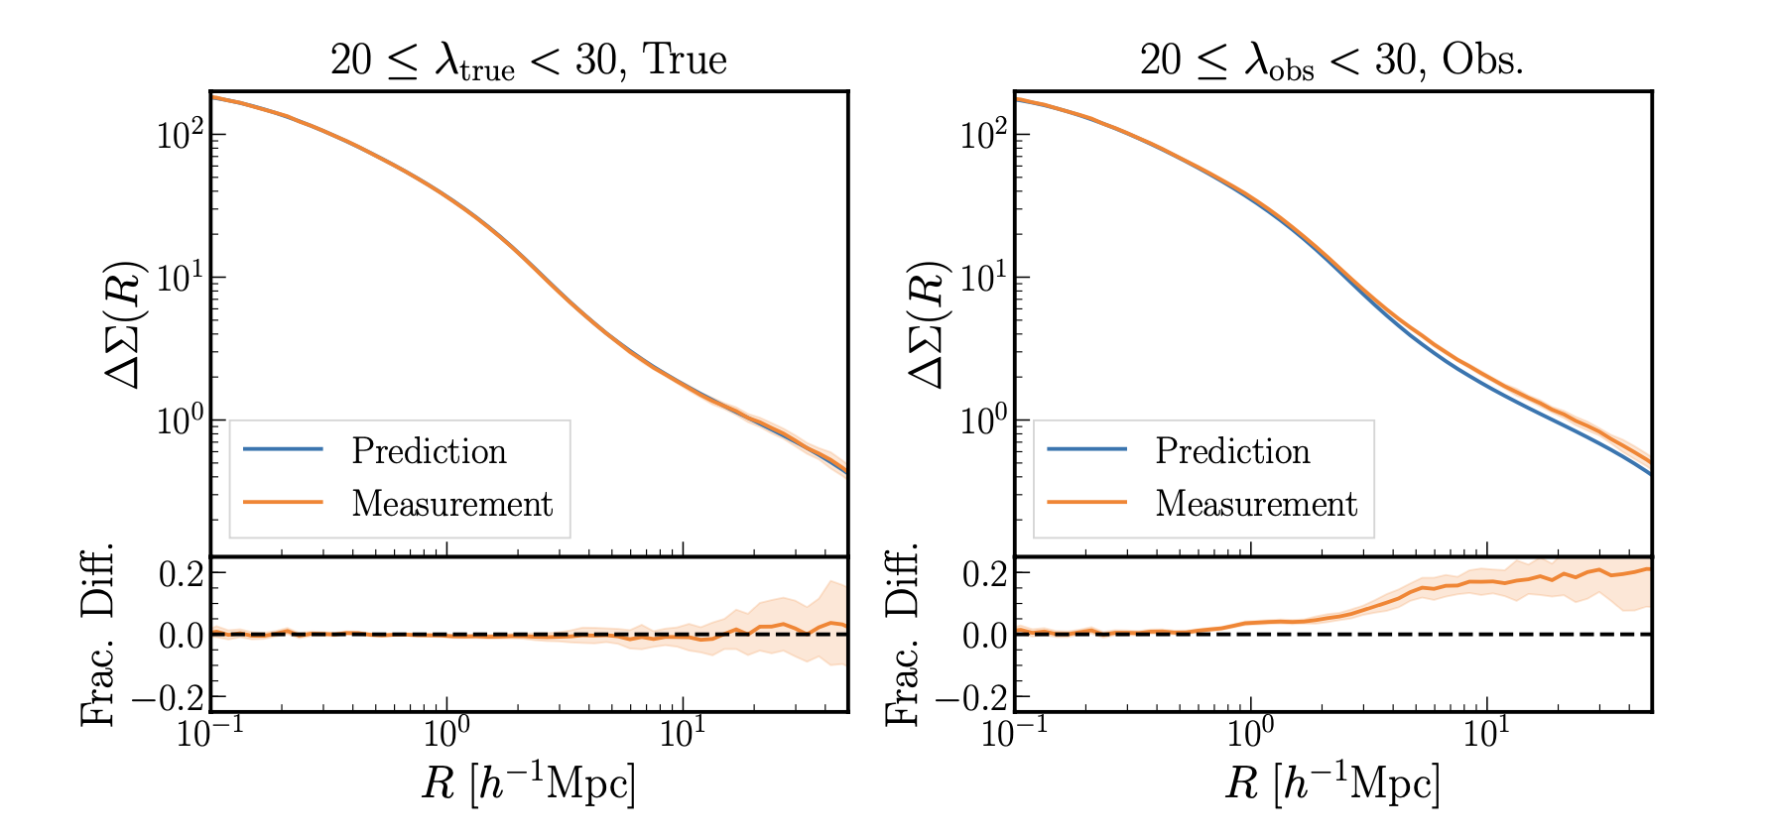
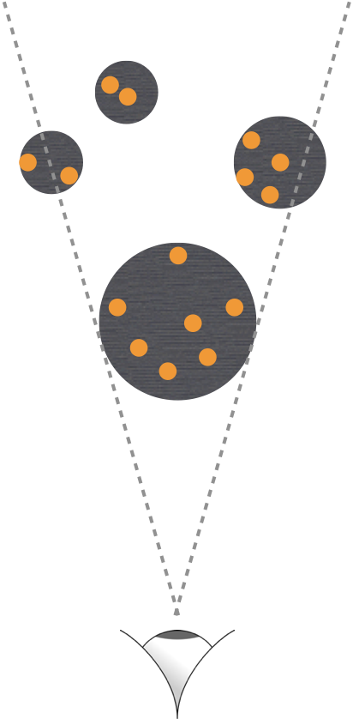
Projection effects
Source: Sunayama et al 2020
It occurs when the optical cluster finder, redMapper, misidentifies galaxies along the line of sight as genuine members of the cluster, leading to an upscatter in the estimated cluster richness.

Slide 17
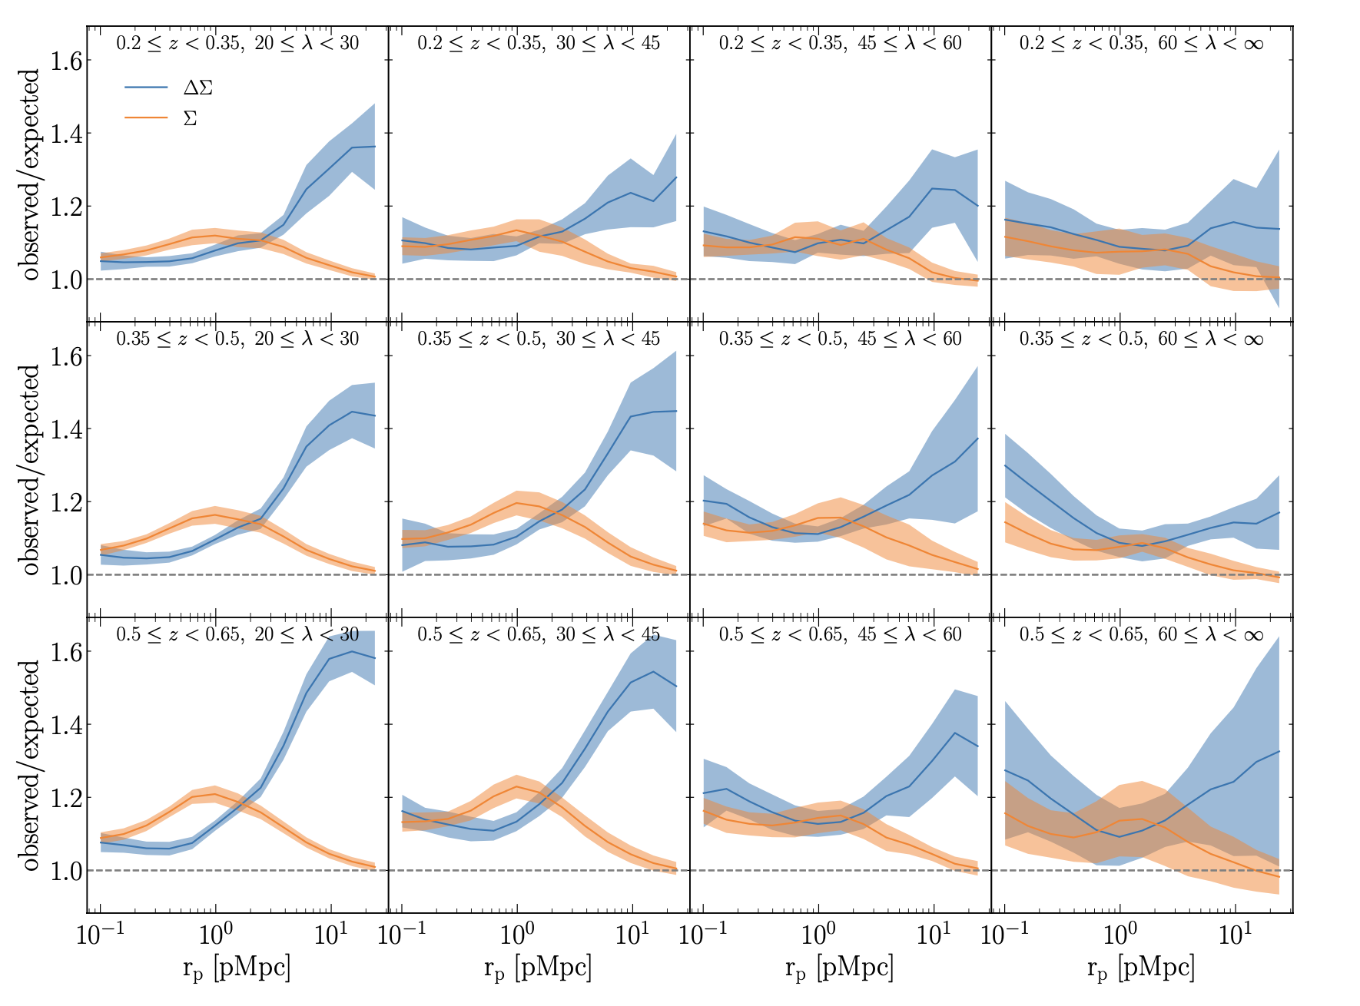
Projection effects
Source: Wu et al, 2022

Slide 18
Projection effects - dominant and not well-understood systematic effect that is expected to be a major challenge in the LSST observatory data analysis due to the depth of the survey.
The source of the discrepancy between DES results and other probes is not clearly known. Dropping the lowest richness bin reduces this discrepancy, however, the study opens the possibility that such bias might affect other low-mass objects. There are ongoing studies with alternative methods like using stellar mass as a mass proxy which is richness-independent.
Gaps

Slide 19
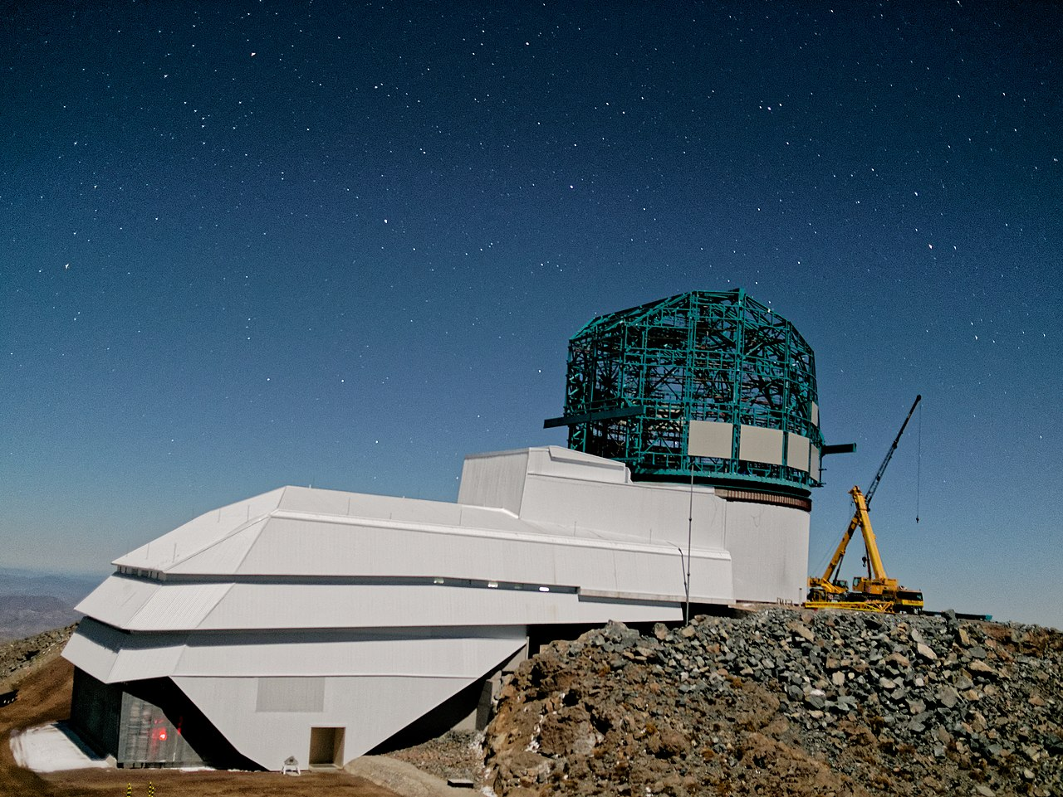
Legacy Survey of Space and Time (LSST)
It is a gravitational lensing-based survey that will start its operation in July 2023. It will take place at Vera C. Rubin Observatory and is expected to conduct a synoptic astronomical survey of the southern sky for 10 years.
Focus areas:
Nature of dark matter and dark energy
Exploring the changing sky
Formation and nature of our Milky Way galaxy
Creating a directory of the solar system
Source: Vera C. Rubic Observatory

Slide 20
My ongoing project: Selection bias quantification
Aim
Quantify the optical selection bias in cluster gravitational lensing using CosmoDC2 data in preparation for the upcoming LSST observatory data.
Compare richness with different mass proxies such as the stellar mass and identify the less biased one.
Give more insights into some of the identified challenges.
Achieved
Extract the two cosmoDC2 catalogs
Match halos with the redMaPPer clusters
Compute the lensing signal of the halos

Slide 21
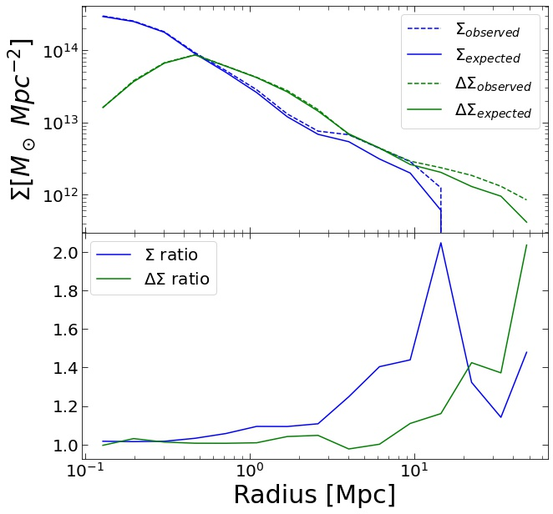
My ongoing project: Selection bias quantification
Observed/Expected

Slide 22
Conclusion
The derived cosmological parameters from galaxy clusters using recent DES data exhibit discrepancies when compared to other probes. Further probe shows that the derived low Ω_{m} is originating from the wrong interpretation of the weak lensing mass. This implies there are systematics yet to be captured by the model. This motivates the need for further observational and simulated-based analysis.
Projection effect is an active research area expected to be a dominant systematic effect in the LSST observatory data due to the depth of the survey.
The computing artifact prepared for this synthesis is publicly available on GitHub

Slide 23
Observational Systematics
The derived cosmological parameters from the observational data include observational systematics. It is, therefore, necessary to reconcile the observational and simulation-based analysis to tightly calibrate the cosmological measurements.
In this study we focused on the following systematics:
Projection effects
Shear and photometric redshift systematics
Cluster member dilution
Cluster miscentering

Slide 24
Observational Systematics
Shear and photometric redshift systematics
Galaxy shear is estimated from the observed galaxy images which are affected by several factors;
Point Spread Function
Noise bias such as Galaxy blending due to poor resolution
Distance to the cosmological objects is not known but rather estimated using photometric redshift. Photometric redshift is also estimated from the galaxy flux.

Slide 25
Observational Systematics
Cluster member dilution
Foreground galaxies can be included in the source galaxies. They have a 0 WL signal; therefore leading to an underestimation of the weak lensing signal. This result in an underestimation of the weak lensing mass.
Cluster miscentering
Miscentering of clusters refers to when the sky location of cluster centers gets misidentified. It leads to discrepancies between the true and observed underlying matter distribution. Weak lensing surveys lead to underestimating the lensing signal and galaxy number density, biasing the cluster mass estimation.

Slide 26
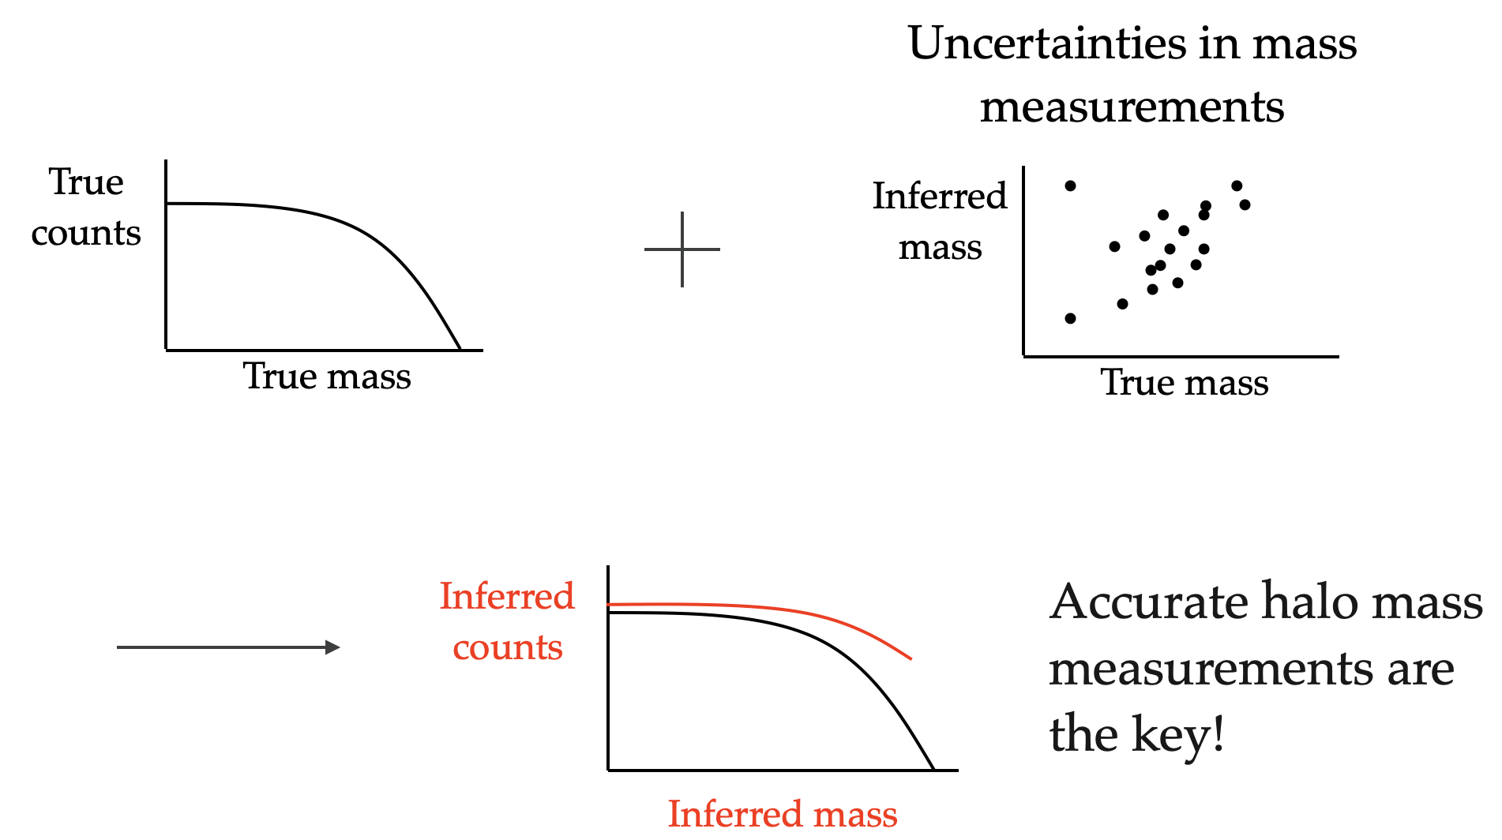
Richness-mass relation
HMF from Theory
Abundance
Richness
Observed abundance vs. richness
Abundance
Richness

